Slide 1
FACIAL EXPRESSION BASED MULTIMEDIA RECOMMENDATION SYSTEM
MENTOR:
MRS.SANGEETHAPRIYA
TEAM MEMBERS:
JANAVIKA A
SINDHUJA S
KARTHI SARAVANA O
PRAVEENRAJ R

Slide 2
Abstract
This project delves into the synergistic realms of facial expression recognition technology and music generation using deep learning techniques. The first part introduces a novel approach for personalized multimedia recommendation based on real-time facial expression analysis.
Leveraging OpenCV and Mediapipe. the system detects emotions such as happiness, sadness, and surprise, offering tailored recommendations from platforms like YouTube and IMDB.
Moving to the realm of music generation, the project employs Long Short-Term Memory (LSTM) networks within the Keras library to compose intricate music sequences. Exploring AI's creative potential, the system utilizes the Music21 Python toolkit to manipulate musical elements from MIDI files, including notes and chords.
This fusion of AI-driven recommendation systems and advanced music composition techniques aims to enhance user engagement and satisfaction, showcasing the transformative power of AI in reshaping multimedia experiences.

Slide 3
Objective
Implement Real-Time Facial Expression Analysis:
Develop a system using OpenCV and MediaPipe to analyze facial expressions in real-time.
Detect and classify emotions such as happiness, sadness, and surprise from facial expressions.
Integrate Emotion Analysis into Multimedia Recommendation:
Integrate the detected emotions into a multimedia recommendation engine.
Recommend songs on YouTube and movies on IMDb based on the user's emotional state and preferences.
Develop an AI-Driven Music Generation System:
Utilize Keras and LSTM networks to create an AI-driven music generation system.
Compose music sequences based on the detected emotions, offering a unique musical experience.
Create an Interactive User Interface with Streamlit:
Design and implement a user-friendly interface using Streamlit.
Provide input options for language preferences, singer choices, and other user preferences.

Slide 4
Existing system
One existing system that can be compared to my project is Spotify's personalized recommendation system. Spotify uses machine learning algorithms to analyze user listening habits, preferences, and context (such as time of day or mood) to recommend music tailored to each user
However, unlike our project, which incorporates real-time facial expression analysis and emotion-based recommendation, Spotify primarily relies on user behavior data and collaborative filtering techniques
our project adds a unique dimension by integrating facial expression analysis for more personalized and emotionally relevant multimedia recommendations.
And also adding a music generation is add-on advantage because user try to explore the new calm music

Slide 5
Proposed System
The proposed system is a Facial Expression Multimedia Recommendation System. It integrates facial expression analysis using OpenCV for mood detection and music generation for new music creation based on dataset piano midi connection to engage users Experience.
In Facial Expression we can do in OpenCV and mediapipe for Detect the mood and give the result platforms like YouTube, IMDB movies links based on the user's detected mood and give a result in webpage.
In facial Expression we capture the face and also we provide the language and singer name for user easy listen the song in user known language and user favorite singer.
Keras with LSTM networks for music generation In the music Generation we use the dataset (piano midi) collection and that midi collection data we done pre processing and trained the data and that trained model converted into pickle file then we used to that model to generate the music.
Design an interactive and user-friendly interface using Streamlit.Provide input options for language preferences, singer choices to make better experience.

Slide 6
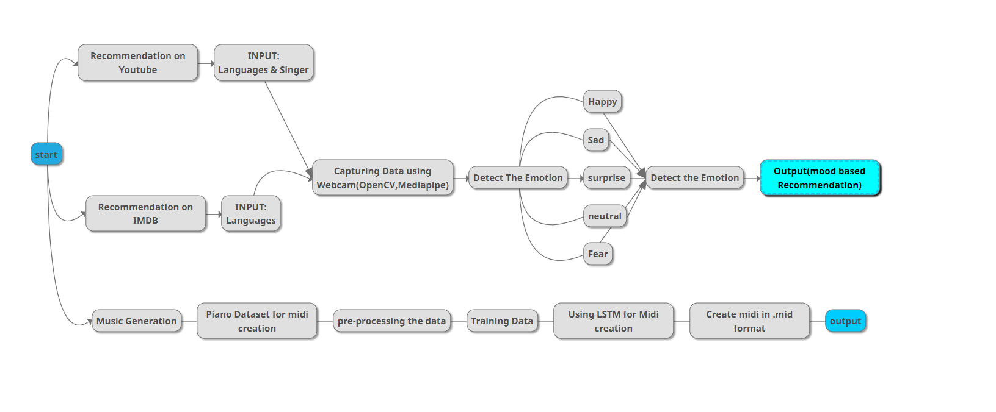
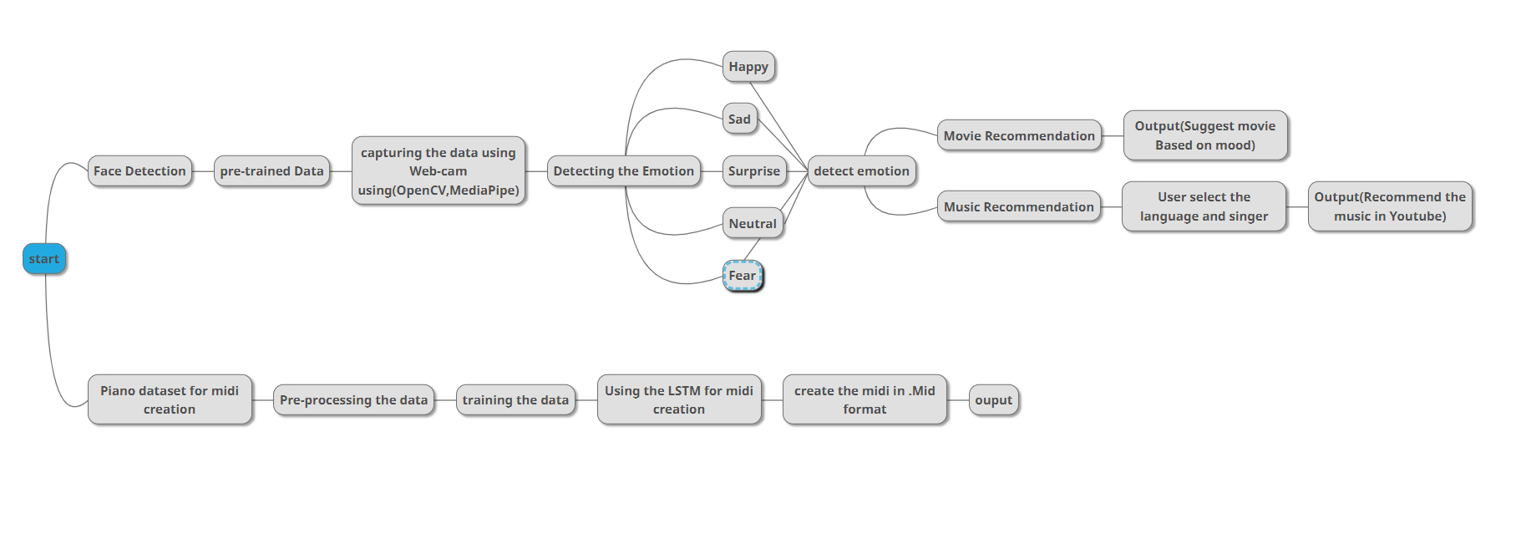
System Diagram

Slide 7
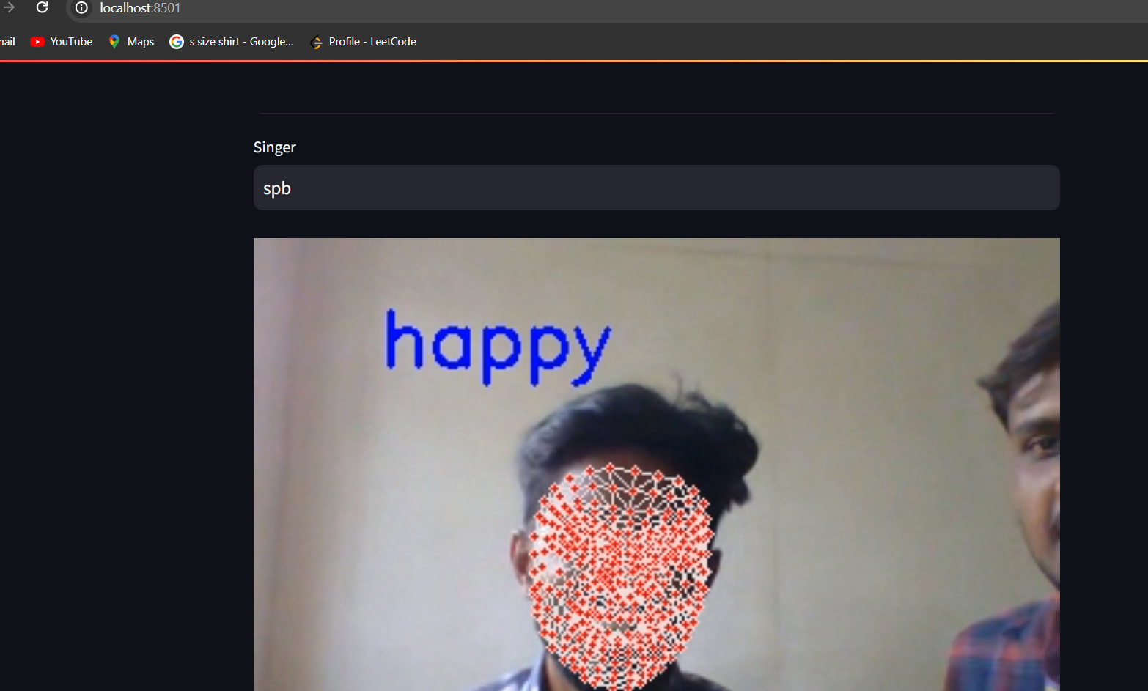
MODULE PRESENTATION
Facial Expression Recognition Module:
Facial Detection: Identifies and locates faces via OpenCV.
Facial Landmark Detection: Determines key facial landmarks for feature analysis. We develop in media-pipe library to detect the facial landmark to analysis the mood.

Slide 8
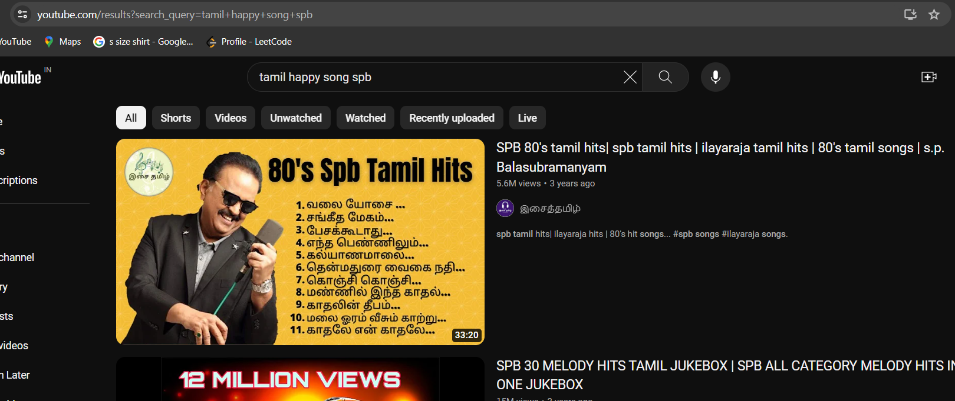
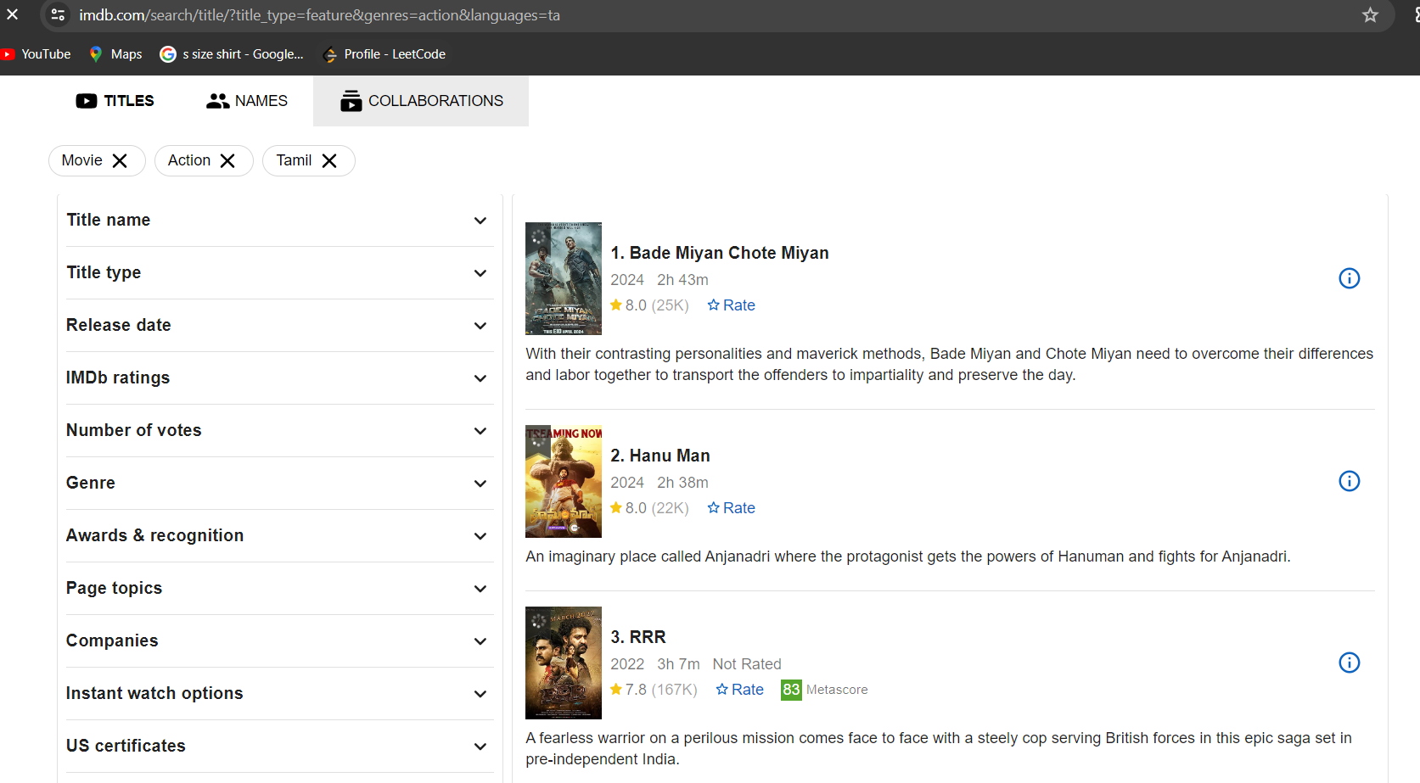
MODULE PRESENTATION

Slide 9
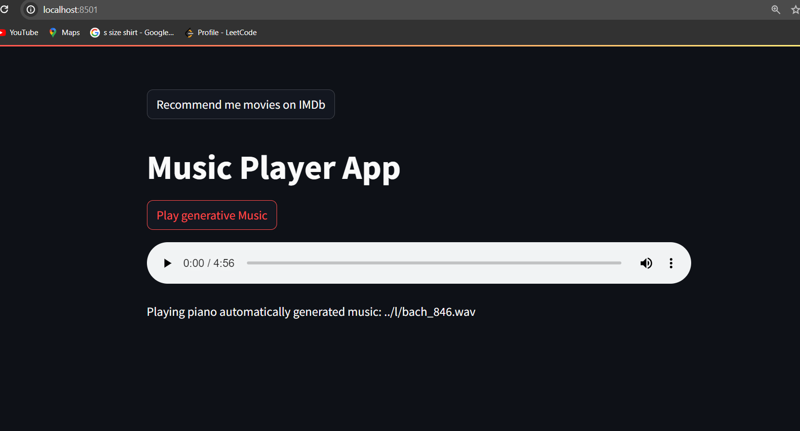
MODULE PRESENTATION
2.Music Generation
we using a Midi generation model for mid format training data to generated Wav format file using LSTM.
In the Model we give a piano mid file to generated a calm piano music.
If user Don’t know what song is playing or bored music playing in Youtube. The music player generate a new music using a Piano trained LSTM model.

Slide 10
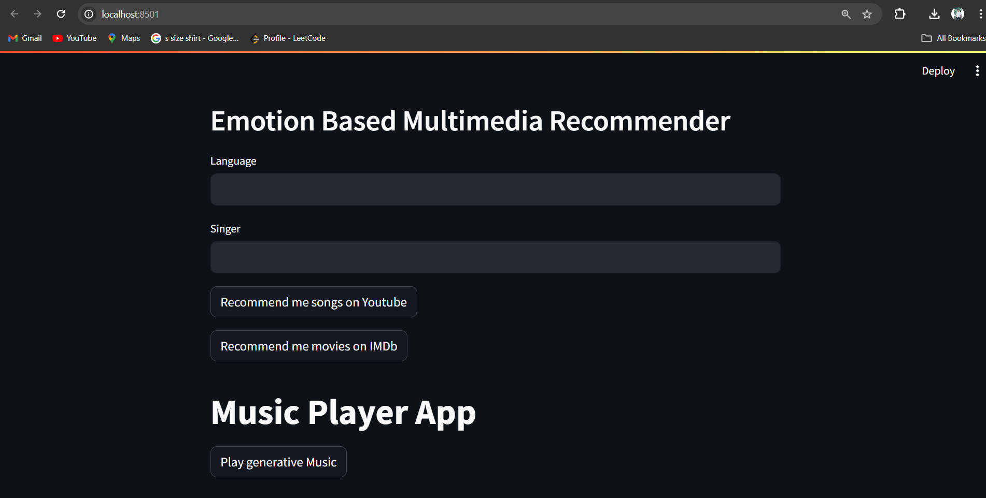
MODULE PRESENTATION
3.User Experience Optimization Module:
User Interface Design: Designs an intuitive and user-friendly interface for seamless interaction. We using Stream-lit python framework for Front end for efficient System.
Performance Optimization: Ensures fast response times and efficient system operation.

Slide 11
Conclusion
In conclusion, the proposed system offers advancements in personalized music recommendation by addressing existing limitations and leveraging advanced technologies. Through enhanced facial expression recognition and LSTM Model music generation, the system delivers more accurate and tailored recommendations. Additionally, the refined recommendation algorithm ensures diverse music suggestions aligned with individual preferences and contextual information. Prioritizing user experience with optimized usability and performance, the proposed system holds promise for enhancing music discovery.

Slide 12
REFERENCE
https://www.ijert.org/research/multimedia-recommender-system-usingfacial-expression-recognition-IJERTV9IS050481
https://www.researchgate.net/publication/341875035_Multimedia_Reco mmender_System_using_Facial_Expression_Recognition
https://www.researchgate.net/publication/351379012_Analysis_of_Intelligent_movie_recommender_system_from_facial_expression
https://ijcrt.org/papers/IJCRT2311158.pdf
https://www.irjmets.com/uploadedfiles/paper//issue_1_january_2024/48 317/final/fin_irjmets1705053367.pdf

